Slide 1
An Informal Session with SimSmith and the nanoVNA
Ward Harriman
AE6TY

Slide 2
SimSmith 18.3 Introduces ‘nanoVNA Connect’
SimSmith utility to connect to nanoVNA over USB
Provide for download of untethered measurement
Provide standard SOLT calibration and 12 term correction
Provide 5 different measurement configurations
Save s1p and s2p files
Compare measurements with SimSmith models

Slide 3
What’s coming
This is a ‘watch over the shoulder’ presentation.
Informal, LONG
Ad Hoc
Has dead ends
May use ‘stupid’ techniques
Intended as a learning experience about the tools and capabilities
NOT a tutorial on the best techniques to use. I’m still learning THAT!

Slide 4
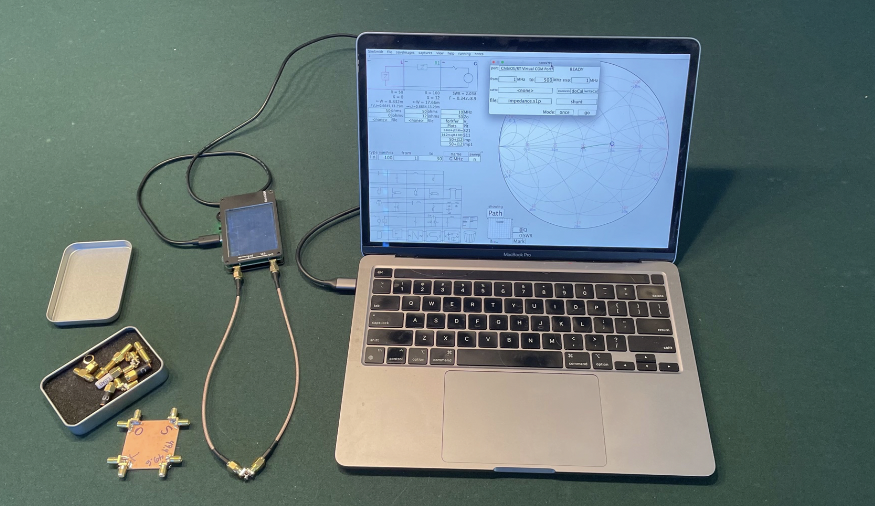
The Work Environment

Slide 5
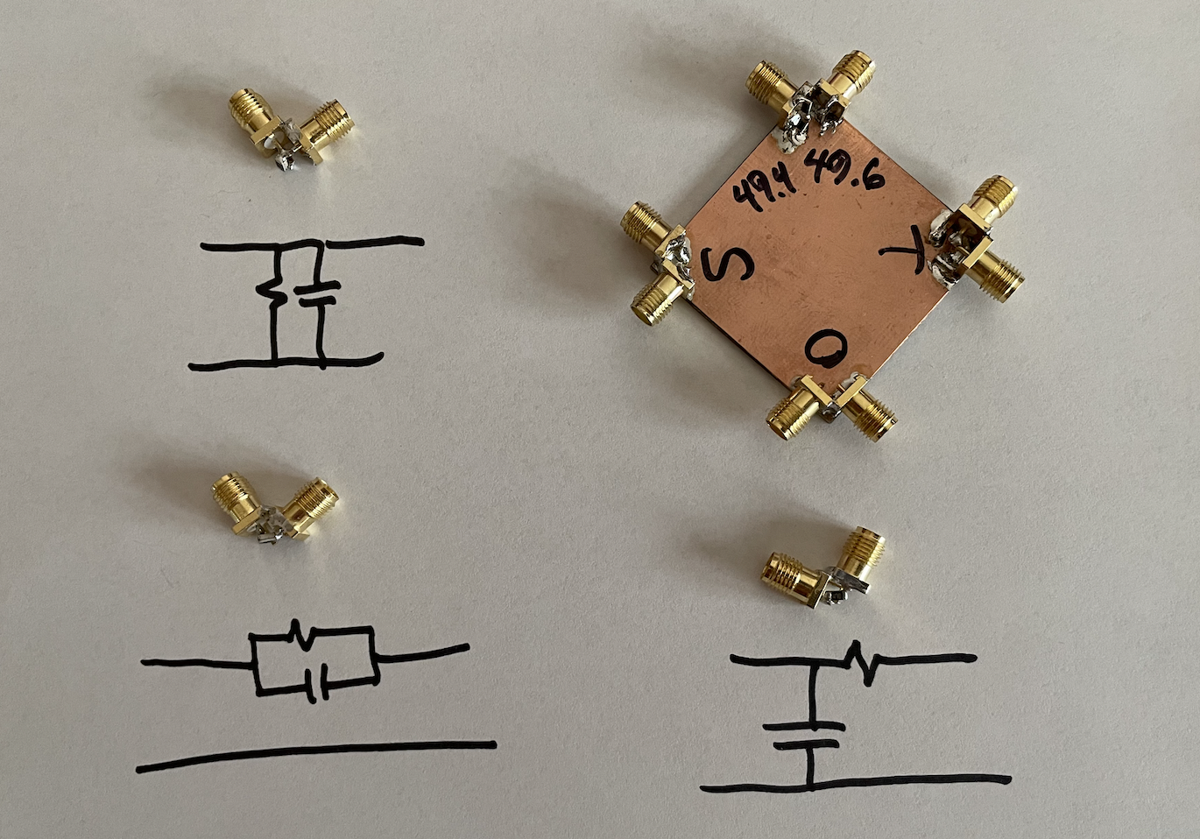
Standards and Devices to Test

Slide 6
Let’s Get Started
Remember…
this might be quite long and…
this is pretty ad hoc.
The goal is to get acquainted with
nanoVNA Connect
Simsmith
How to use them in parallel.
So, when reasonable, I will have you watch as I enter circuits.

Slide 7
Invoking nanoVNA Connect
Start dialog using view/nanoVNA Connect
Select the port from the list
Example:
Can load previously made measurement….

Slide 8
Load Previously Measurement
Change mode to ‘retrieve once’
Notice calibration options disappeared
Set connection to ‘reflection’
Click ‘once’
Notice sweep parameters changed and sweep was displayed.

Slide 9
That was nice but, where’s the meat?
The file we just downloaded as already captured and corrected
BUT: nanoVNA Connect can do all the calibration and capture by directly controlling the nanoVNA.
The first step is…. Calibration.

Slide 10
Calibration using nanoVNA Connect
At the beginning of every session, you should calibrate…. ALWAYS !
WHY? You might have unknowingly changed things, even swapping two seemingly equivalent cables can make a difference.
Especially at higher frequencies.
It only takes a few seconds !!!
Remember: Friends don’t let friends skip calibration!

Slide 11
Calibration Procedure Overview
Start calibration by clicking on ‘doCal’
Measurements:
Attach an open and hit OK.
Attach a short…
Attach a known load AND terminate the other port.
Connect the two ports together
THEN…

Slide 12
Standards
Click on ‘standards’
Initially ignore:
the offsets
the load capacitance
Just set:
load Z (usually purely resistive)

Slide 13
Write the Calibration Information
Not strictly necessary BUT….
Info will be lost when SimSmith is restarted unless you write it out.
Click on writeCal
Specify the file to write. Should have an ‘nvCal’ extension.

Slide 14
What does a nanoVNA Measure
The nanoVNA is really a 1 and 1/2 port device:
It measures ‘reflection’ often referred to as ‘S11’
It measures ‘through’ (kind of) often referred to as S21
IT DOES NOT measure ‘S22’ or ‘S12’ directly
To do THAT you need to reverse the device and make a second set of measurements.
Only with device measured in both directions are all parameters truly known.

Slide 15
A Little Backwards Now.
This presentation starts with the ‘complete’ solution to the two-port device measurement. This can seem complicated.
But, having understood the complete solution it is easy to see where some shortcuts are possible.
And we will explore those short cuts to make most jobs much easier.

Slide 16
The Complete Solution
A complete measurement of a two-port device requires two steps:
Measure the device recording S11m and S21m…. The ‘m’ means measured.
Reverse the device and
Measure the device recording S22m and S12m.
Restore the device
Using S??m measurements and the data from the previous calibration, compute the actual S11, S21, S12, and S22 parameters.

Slide 17
Example 1, an Asymmetric Device:
Here is a schematic of our first example drawn using SimSmith’s RUSE schematic editor.
A signal will be injected from the right. Reflection is on the right and transfer is on the left.
(YES, this is backward land)

Slide 18
Comparison
We will use an S block to examine the S2P file.
We will compare it to your SimSmith model.
We will inspect the S parameters measured.

Slide 19
Here is the SimSmith Circuit We will use:
The original RC circuit (show above) is in the RUSE block.
The S block will be used to display the measured data.
The traces of ‘A’ and ‘S1’ should overlap.
Examine:
S12 compared to S21 (transfer, passive)
S11 compared to S22 (reflection)

Slide 20
Differences (Major Diversion Coming)
Model and measurements don’t match.
Could be many reasons:
nanoVNA is defective
Calibration standards are inaccurate
Model is inaccurate
Let’s explore the last:
Change values of things
Add components. ALL VERY ad hoc…

Slide 21
RETURN FROM DIVERSION: Lessons (well, suspicions)
The S21 and S12 parameters appear to be equal.
Turns out this is always is true for passive devices.
If your device is passive and if they aren’t close: there was a problem
S11 and S22 are NOT equal.
If they were equal, the device would be ‘symmetric’.
Remember that, for passive devices, S21 is the same as S12.
So a ‘symmetric’ device shouldn’t need to be reversed.
Let’s to check.

Slide 22
Examining Symmetry
Left/Right symmetry
Reversing device shouldn’t matter
Let’s verify that.
Use familiar SimSmith circuit to do compare.

Slide 23
Here is the SimSmith Circuit We will use:
The original RC circuit (show above) is in the RUSE block.
The S block will be used to display the measured data.
The traces of ‘A’ and ‘S1’ should overlap.
Examine:
S12 compared to S21 (transfer, passive)
S11 compared to S22 (reflection)
Not exact…. But close!!!

Slide 24
Symmetric Measurement
If we know something is symmetric:
We can SKIP actually reversing the device and just repeat the measurement
Or
We can tell nanoVNA to assume it is symmetric and skip the measurement

Slide 25
Special case of ‘shunt only’ device.
This circuit is special in another way:
the voltage on the left is the same as the voltage on the right
the device can be completely characterized using a single ‘impedance’
How can we compute that impedance?
Use S11
Knowing S11 = (Z-Zo)/(Z+Zo)
Say Ze = ArcGamma(Z,Zo)
Then Z = ZoZe/(Zo-Ze)
Using S21
Z = Zo*S21/(2*(1-S21));

Slide 26
Comparing Computations.
In theory, computation should be exactly the same because, ideally, S21-S11 = 1 IN THIS PURELY SHUNT CONFIGURATION
In practice, there is a difference.
Literature indicates that using S21 is more tolerant of measurement errors.
We’ll come back to this later.

Slide 27
NanoVNA Connect Short Cut.
If you are willing to stipulate the device is perfectly symmetry
(or close enough as ‘never-mind’)
AND if you know it is a purely shunt device.
nanoVNA connect can do the calculation using the S21 approach automatically.
Select the shunt mode. Notice the extension is now ‘s1p’ meaning an impedance file will be written…. And hit ‘go’.

Slide 28
Compare the results.
Use SimSmith to plot the two impedances.
Imports the measurement.
Plot all the ways it can be computed…
Computed using S11
Computed using S21
Computed using both
Computed by nanoVNA Connect (same as using s21).

Slide 29
Special case for Series
Just as with the shunt device, a ‘known to be’ purely series device can be fully characterized using just an impedance.
To create an impedance (s1p) file for a series device, select the ‘series’ configuration.

Slide 30
Computing Series Impedance
Just as with the shunt configuration, you can use a single impedance to describe the series part. The formulas are:
Knowing S11
Ztmp = ArcGamma(S11,Zo);
Z = Ztmp-Zo;
Knowing S21
Z = 2*Zo*(1-S21)/S21;

Slide 31
Measuring an Impedance using Reflection.
Probably he most familiar impedance measurement made:
this is how antenna analyzers work.
Let’s go back to the ‘shunt’ device and measure it using ‘reflection’.

Slide 32
Third way to Measure Impedance
Insert shunt device
Disconnect Port 2 from nanoVNA
Select ‘reflection’ connectivity
Compare (set L and LG1 to 1G).

Slide 33
Summary
Showed how to connect to nanoVNA
Downloaded a previously made and corrected measurement.
Demonstrated calibration procedure
Demonstrated 5 ways to make measurements
Asymetric
Symetric
Shunt
Series
Reflection
Demonstrated how to save files and display results
Compared various measurements with circuit model
Made mistakes and showed out to detect and recover from them.

