Slide 1
nanoVNA Connect (Cliffs Notes)
Ward Harriman
AE6TY
9-Jul-21

Slide 2
Invoking nanoVNA Connect
Start up SimSmith version 18.3 or newer
Click on ‘view’ and then ‘nanoVNA Connect’
Select the serial port

Slide 3
Retrieve a Measurement
Click on the mode button until ‘retrieve once’ is seen.
Specify where to put the file
Click ‘go’
Result imported into SimSmith.

Slide 4
Calibration
Click on ’mode:’ until the calibration information is seen.
Click on ‘doCal’ and follow directions
Connect ‘open’ standard
Connect ‘short’ standard
Connect ‘known load’ and terminate other port
Connect ‘through’
Click on ‘standards’
Specify value for known load
Click on ‘writeCal’
Specify where to write the calibration

Slide 5
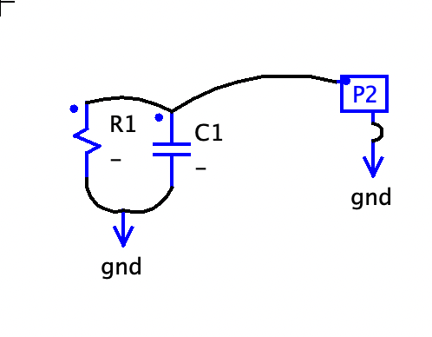
Making an Impedance Measurement (1 port)
Change mode to ‘once’
Change connection type to ‘reflection only’
Connect just 1 port
Click ‘go’
‘s1p’ impedance file is imported into SimSmith
(Sorry about port naming)

Slide 6
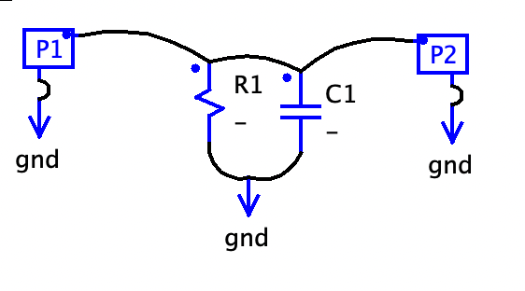
Making an Impedance Measurement (shunt configuration)
Change mode to ‘once’
Change connection type to ‘shunt’
Connect both ports
Click ‘go’
‘s1p’ impedance file is imported into SimSmith
(Sorry about port naming)

Slide 7
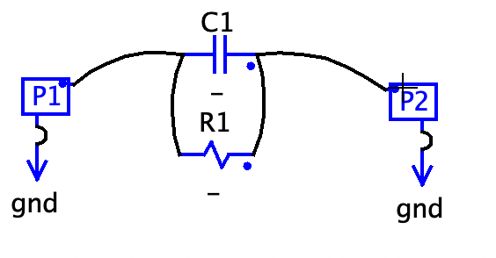
Making an Impedance Measurement (series configuration)
Change mode to ‘once’
Change connection type to ‘series’
Connect both ports
Click ‘go’
‘s1p’ file is imported into SimSmith
(Sorry about port naming)

Slide 8
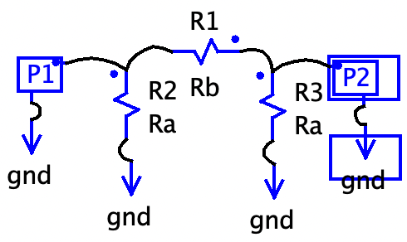
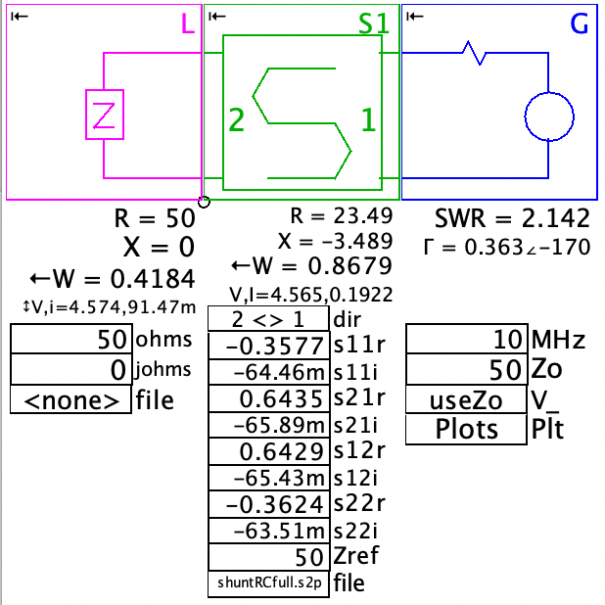
Measuring all 4 Scattering Parameters (known to be symmetric)
Change mode to ‘once’
Change connection type to ‘NOT symmetric’
Connect both ports
Click ‘go’
’s2p’ file is written
Use ‘S’ block in SimSmith to examine results

Slide 9
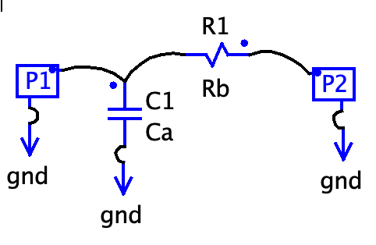
Measuring all 4 Scattering Parameters (known to be symmetric)
Change mode to ‘once’
Change connection type to ‘NOT symmetric’
Connect both ports
Click ‘go’
Reverse device, click ‘ok’
Restore device
’s2p’ file is written
Use ‘S’ block in SimSmith to examine results

Slide 10
Summary
Import previously obtained measurement
Calibrate
Measure impedance of 1 port device
Measure impedance using ‘shunt’ configuration
Measure impedance using ‘series’ configuration
Measure all four S Parameters of symmetric device
Measure all four S Parameters of asymmetric device

