Slide 1
Exploring SimSmith
SimSmith
&
Time Domain Reflectometry
(Using Impedance Measurements)
Ward Harriman
ae6ty

Slide 2
SimSmith Is A Platform
Yes, it does Smith, SWR, and Power charts.
But
It also does Waveforms
and
Can be used to develop other algorithms

Slide 3
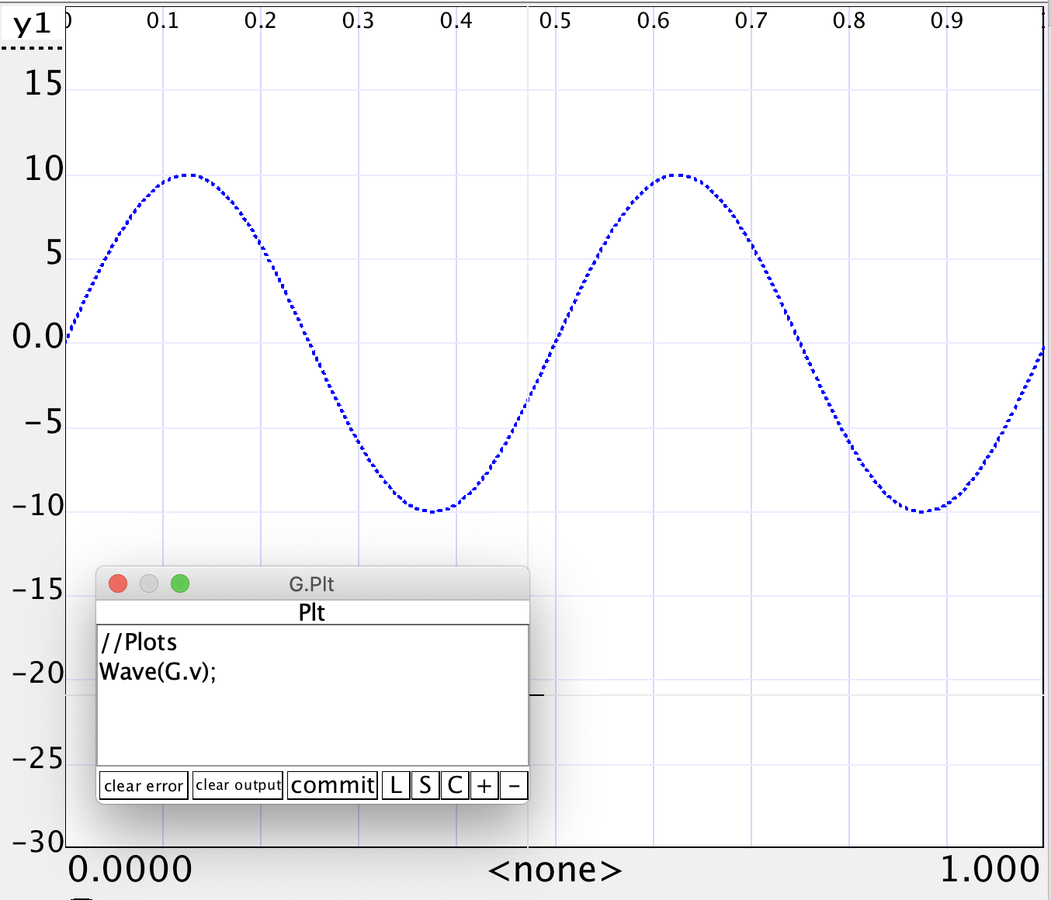
Waveforms
SimSmith can display basic waveforms. Here is the simplest example.
SimSmith always displays two cycles of the waveform (unless you’ve zoomed in).

Slide 4
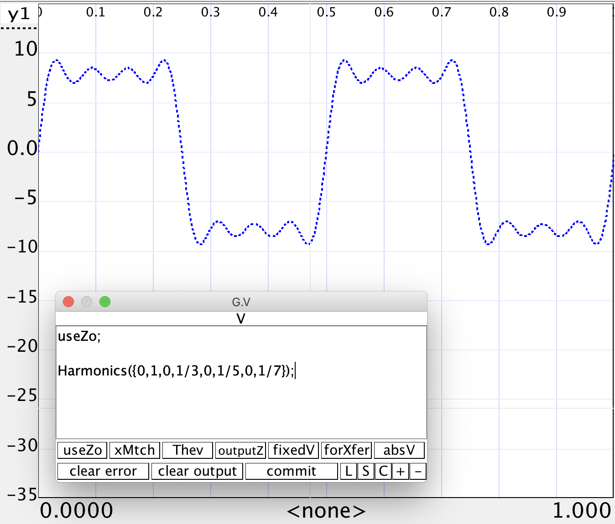
Waveform Harmonics
There are times when the desired excitation is not a simple sine wave. For example, an amplifier might put out a square wave.
SimSmith can describe the waveform using the ‘Harmonics’ function.

Slide 5
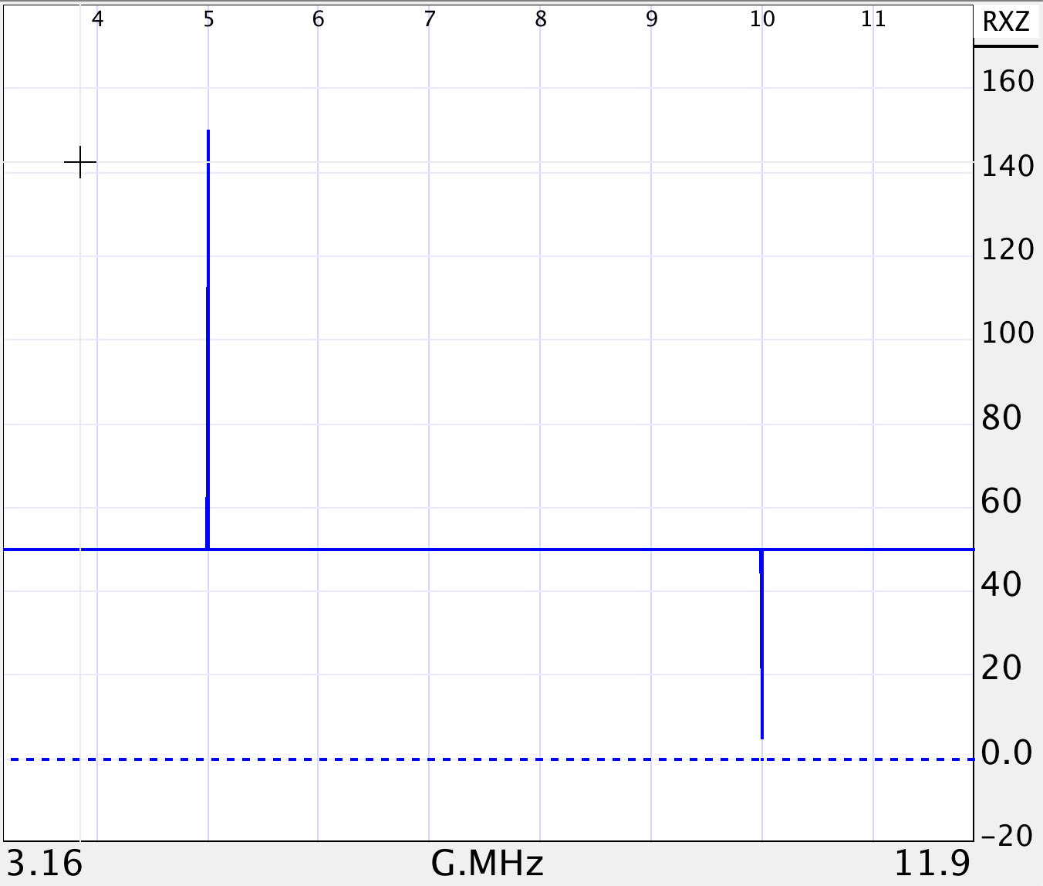
Leveraging
So… how can we leverage this?
How does time domain reflectometry work?
Send a very short pulse down the line
Observe when a reflection occurs
Interpret the reflection

Slide 6
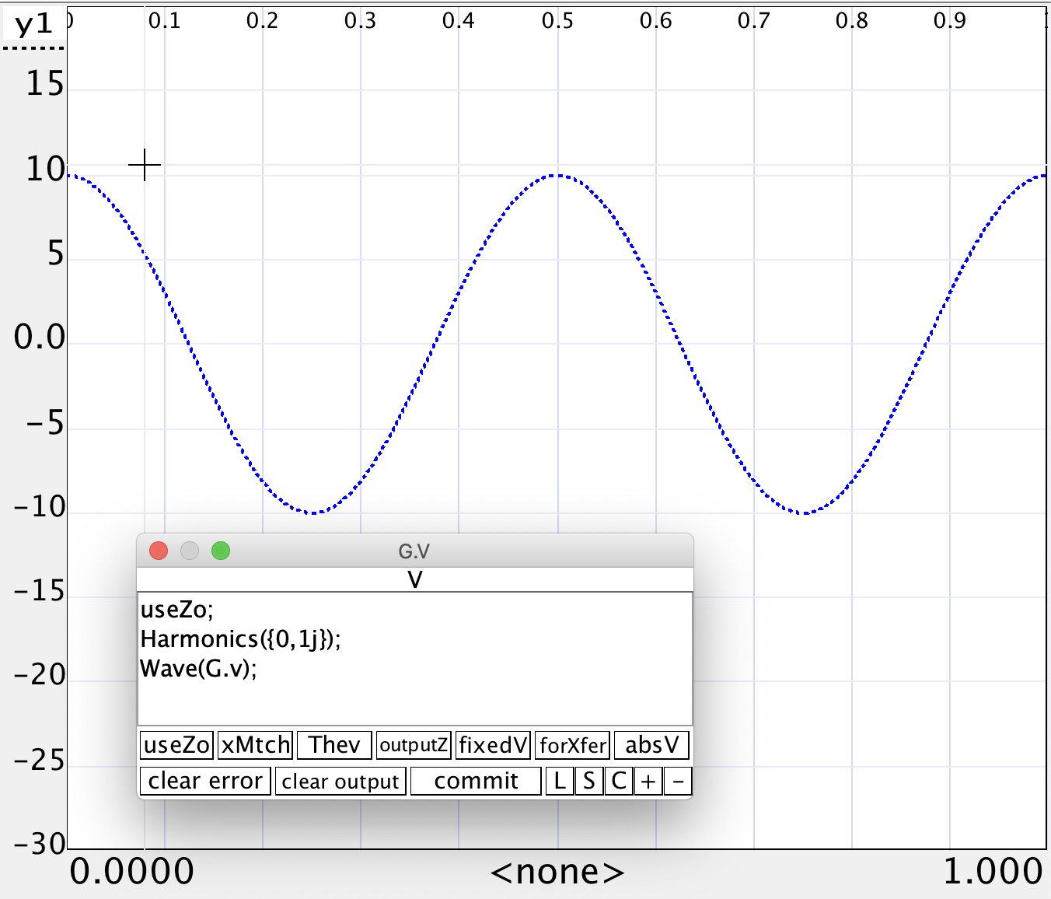
BUT… my VNA doesn’t do pulses
Then, again, neither does SimSmith!
But, we can use the Harmonics() command to synthesize a pulse.
Notice ‘1j’ moves peak to be at center.

Slide 7
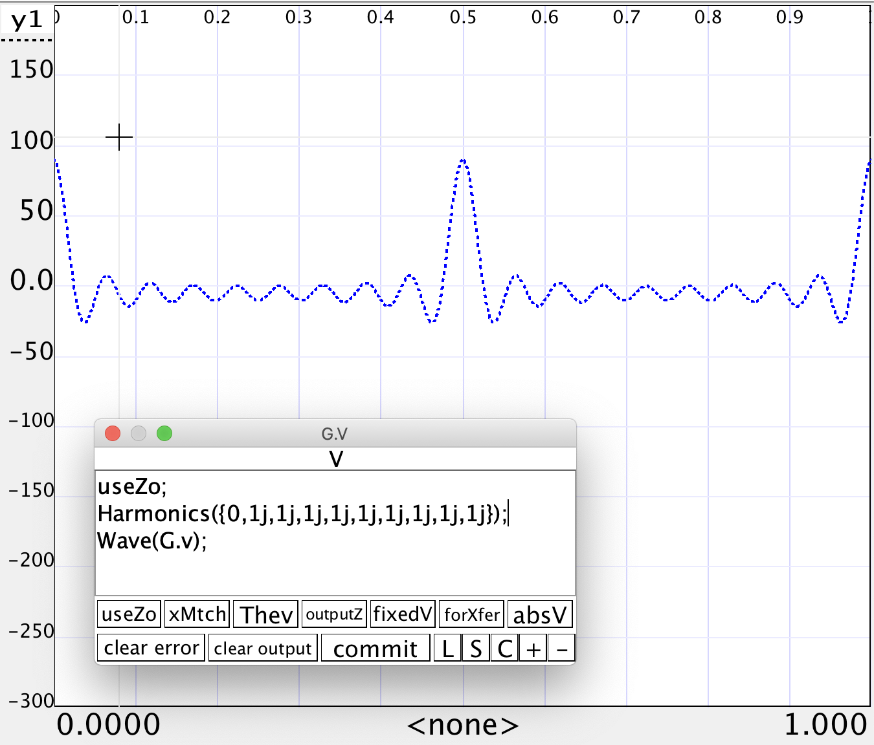
Now let’s make a pulse:
Simply add higher harmonics…
We’re getting there….
It gets tedious adding terms…

Slide 8
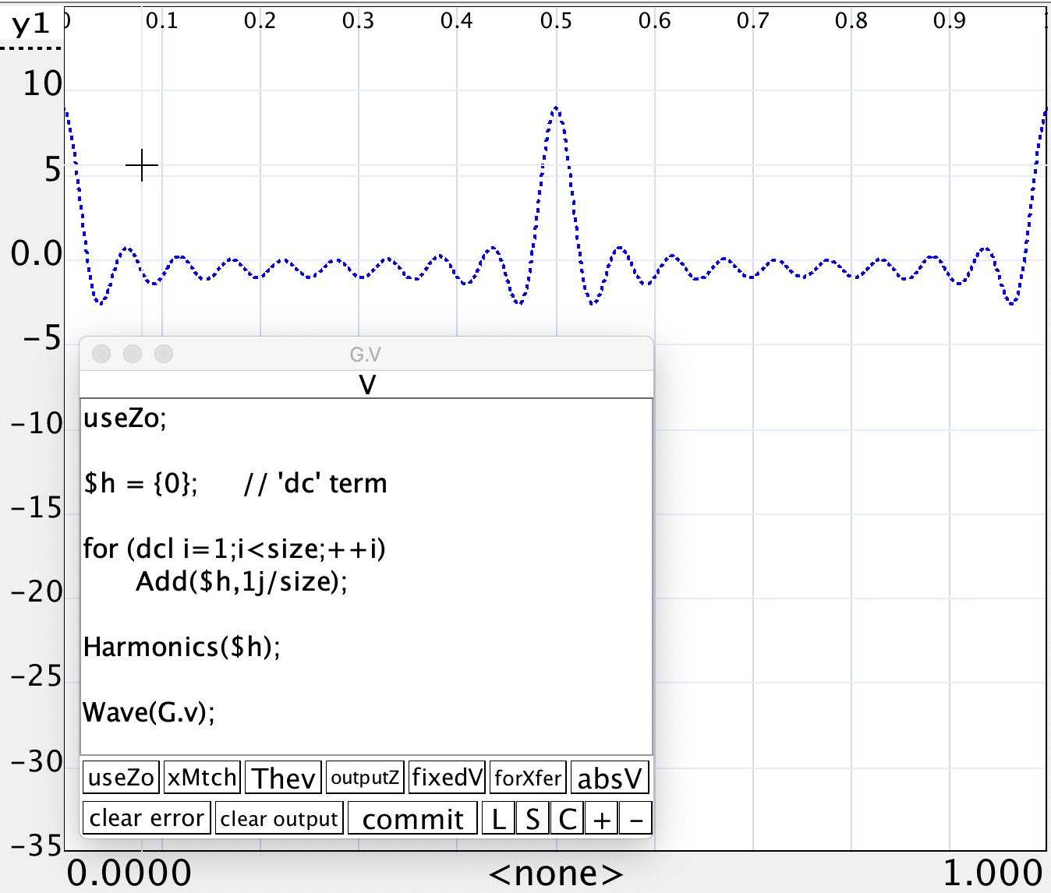
So we’ll write a little program:
Use a parameter and make a list of the desired length…
Note that the harmonics are scaled by ‘size’ so the pulse doesn’t grow taller as we add terms.

Slide 9
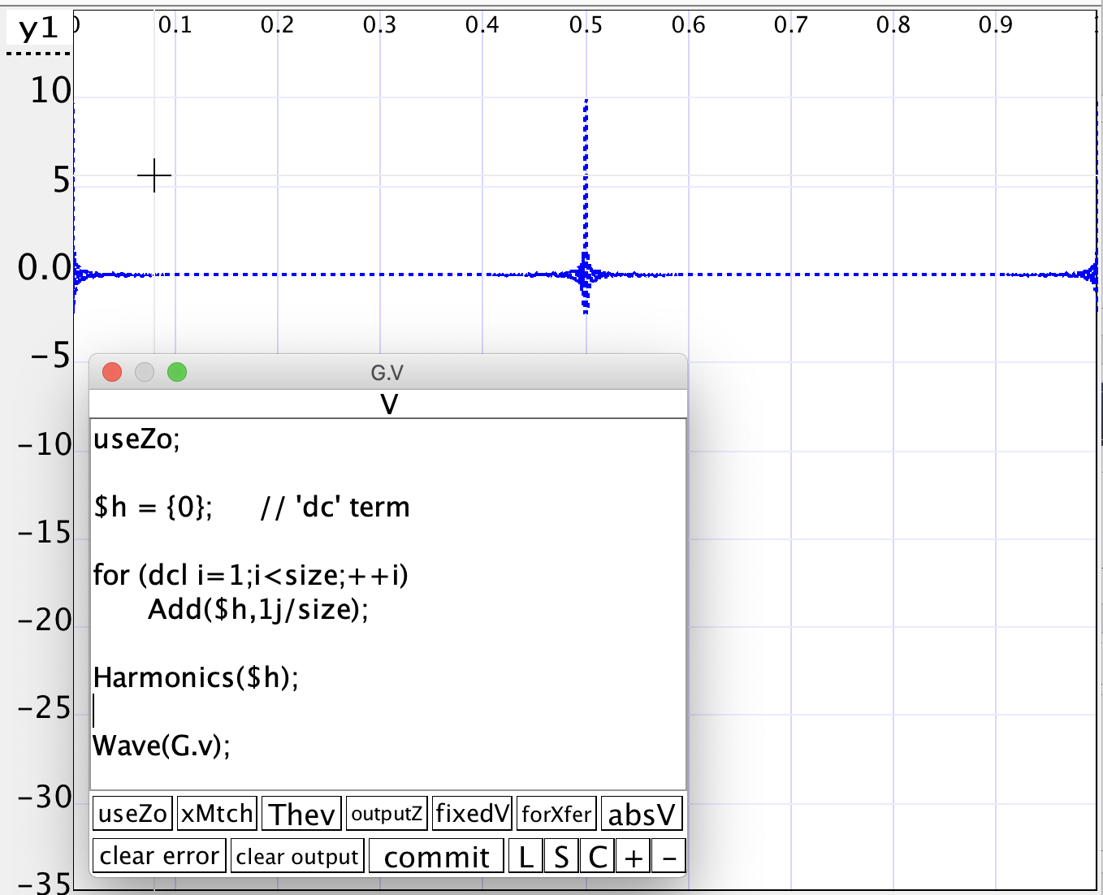
Many terms
Here are 256 terms.
There is some ringing around the pulse; a common effect.

Slide 10
Now, lets use it
We won’t use an impedance file just yet…
Let’s use a simple circuit to verify functionality.
(positive pulses…)
(negative pulses…)

Slide 11
Different Excitation
We can use a square wave to see different details.
Here I changed the length of the second line. The markers show it is ’45ns’ long. At 1000ft/second… that makes the line about 22.5 feet long.

Slide 12
Using Impedance file
I wrote out an ‘s1p’ file that recorded the impedance seen by the generator…
This is just the kind of thing your VNA would measure.
The answer is the same.

Slide 13
Other ways.
SimSmith provides a very general-purpose programming language.
Of key important here:
Reading Impedance Files
Computing the ‘Inverse Fourier Transform’
Why the latter?
We need to translate of bunch of frequency indexed measurements into a time based measurement….
That’s exactly what the ‘Inverse Fourier Transform’ does.

Slide 14
Using SimSmith’s IDFT
Basically, we need to read in the impedance file which is just a bunch of frequency measurements.
Compute the inverse Fourier Transform
Draw the results.

Slide 15
The pieces:
Start with an empty list of ‘impedance/frequemcy measurements’ in ‘file’.
Scan through them converting each impedance into a voltage.
Pad things to the size length you’d like the waveform to have.
Compute the IDFT
Display the results.

Slide 16
Generating the Square Wave Equivalent
Is left as an exercise for the reader.
Hint: the values from the impedance file need to be scaled using the DFT of a square wave.
The DFT of a square wave is:
$\sum_{1}^{n}{1/(2n−1)}$
(Which we already saw….)

Slide 17
Wrap Up
Can use Wave and Harmonics to implement TDR
Can use VNA ‘impedance’ files as fodder for TDR
Can use Fourier and Inverse Fourier transforms to do the same
With a little programming, SimSmith can be used to explore a variety of algorithms well beyond basic Smith, SWR, and Power transfer problems.

